Slide 1


Smart Employee Search Chatbot
Lakshmitulasi Mallampati – G43626084
Priya Ganta – G32494678
Nikhil Derangula – G38763469

Slide 2

Scope
The scope of this project is to develop a cloud-based chatbot using AWS Lex that interacts naturally with users, captures inputs like Username and Department ID, and fetches employee details dynamically from an S3 CSV file using AWS Lambda. The chatbot will provide flexible, real-time data retrieval based on user queries, handle errors gracefully, and enhance user experience through personalized and dynamic conversation flows.

Slide 3

Features Implemented
Personalized greeting capturing user's name.
Query employees by department.
Ask users if they want ID, Salary, or Location.
Top 10 results displayed to users.
Dynamic, flexible conversation flow.
Full error handling for missing/invalid inputs.

Slide 4

Data Sources
Source
Kaggle Dataset (uploaded to Amazon S3 bucket)
File
employeeDetails.csv
Columns
Department ID, Employee ID, Name, Salary, Location

Slide 5

Expected Outcomes
Deployment of a fully functional, intelligent chatbot accessible through Amazon Lex.
Real-time, dynamic retrieval of employee information based on user queries.
Seamless integration and orchestration of AWS services: Lex, Lambda, S3, IAM, and CloudWatch.
Implementation of serverless architecture providing scalability, fault tolerance, and high availability.
Enhanced user experience with personalized greetings, lexible queries, and quick, accurate responses.
Demonstration of effective cloud resource management, security enforcement, and logging practices.

Slide 6

Logical Architecture
The architecture for this project uses a serverless approach, ensuring scalability, reliability, and minimal maintenance.
Amazon Lex: Captures user input (greeting, Department ID, InformationType) and manages dialogue.
AWS Lambda: Acts as the brain that processes the input, queries the S3 dataset, formats a personalized response, and returns it to Lex.
Amazon S3: Serves as a secure storage location for employeeDetails.csv, providing quick data access.
IAM Roles: Securely manage permissions for Lambda to read from S3 without exposing sensitive access credentials.
Amazon CloudWatch: Monitors Lambda executions, collects logs for troubleshooting and performance optimization.

Slide 7
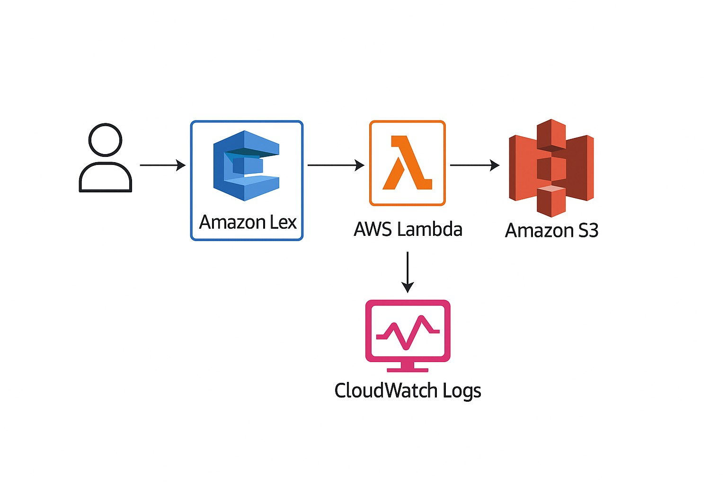
Project Architecture

Slide 8
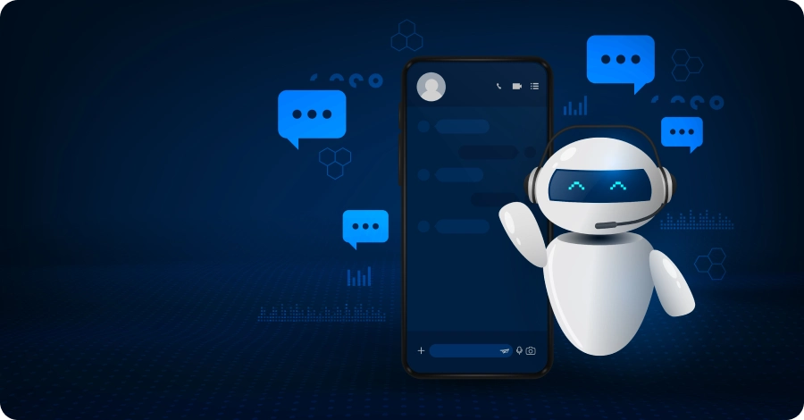
Data Flow
User Interaction: The user initiates a conversation by greeting the chatbot or requesting employee details.
Intent Capture by Lex: Amazon Lex identifies the intent, collects required slots like Department ID and InformationType (ID, Salary, or Location).
Trigger Lambda Function: Once required data is gathered, Lex invokes the AWS Lambda function.
Data Retrieval from S3: Lambda reads the employeeDetails.csv file from Amazon S3, filters data based on Department ID.
Data Processing: Lambda dynamically formats the employee details according to the requested InformationType.
Response Sent to Lex: Lambda returns a formatted response back to Lex.
Response Presented to User: Lex presents the data to the user in a user-friendly text format.
Monitoring and Logging: CloudWatch logs the entire interaction for monitoring, auditing, and troubleshooting purposes.

Slide 9

Cloud Services Used
Amazon Lex: Chatbot front-end.
AWS Lambda: Python backend logic.
Amazon S3: Data source (CSV file).
IAM Roles: Secure Lambda to S3 access.
CloudWatch: Logs for debugging.

Slide 10

Inputs Consumed
User Greeting / Message
(e.g., "Hey", "Hi")
Employee Name Input
(e.g., "John")
Department ID
(e.g., "12")
Query Type Selection
(User chooses one of: "ID", "salary", "location")

Slide 11
Output Produced
Personalized Greeting (e.g., "Hi Priya! I can search for Employees in a department...").
List of Employee Names with requested additional information (Salary, ID, or Location).
Error messages when invalid or no employees are found.

Slide 12
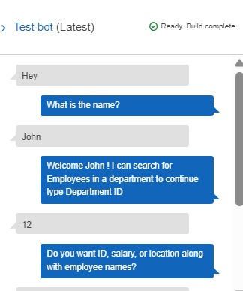
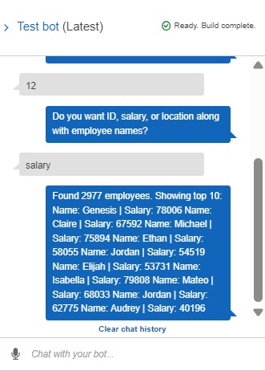
Input & Output Screenshots

Slide 13
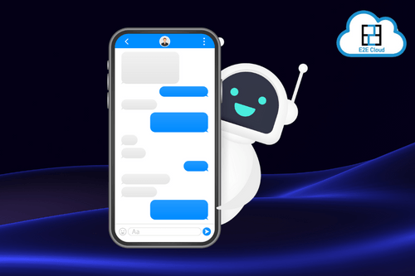
Conclusion
In this project, we successfully built and demonstrated a serverless chatbot using AWS Lex, Lambda, and S3. The chatbot delivers personalized, real-time employee information based on user inputs while showcasing cloud scalability, security, and seamless integration between services. The system effectively handles validation, dynamic queries, and logging, making it a robust and practical application of AWS cloud services for real-world business use cases.

Slide 14


